Slide 1
Maps, Mobility, and Community Participation among Adults with Psychiatric Disabilities: Implications of Geographic Methods for Studying Physical Health
Mark Salzer, Ph.D.
Professor and Chair
Department of Rehabilitation Sciences, Temple University
Director, Temple University Collaborative on Community Inclusion
For more information about these issues please go to www.tucollaborative.org or send an email to Mark.Salzer@temple.edu
The reported studies were supported by grant H133B100037 to Temple University (Dr. Salzer, principal investigator) from the U.S. Department of Education, National Institute on Disability and Rehabilitation Research (NIDRR).
Presented at UIC State of Science 2014 Conference
Notes:
Who are you?
Spend a minute writing down 5 things you think about people with schizophrenia
Spend a minute writing down 5 things you think about people with depression

Slide 2
Why Use Geographic Methods to Study Health of Individuals with Psychiatric Disabilities?
Environmental factors may be related to health outcomes
Where you live and what you are exposed to may affect your health
Mobility and community participation are indicators of health status
Mobility as an outcome of health interventions (e.g., interventions to decrease sedentary behavior that lead to increased morbidity and mortality)

Slide 3
International Classification of Functioning, Disability, and Health (ICF: WHO, 2002): The Social Model of Disability
Health Condition
(Disorder or Disease)
Body Functions and Structure
Activity
(Execution of a task or action)
Participation
(Involvement in a social situation)
Personal Factors
Environmental Factors
Contextual Factors

Slide 4
Geographic Information Systems (GIS)
Mapping
Where do people live?
What are the community characteristics that they are exposed to?
Exposure and outcomes
Distance and Density
Access to health resources?

Slide 5
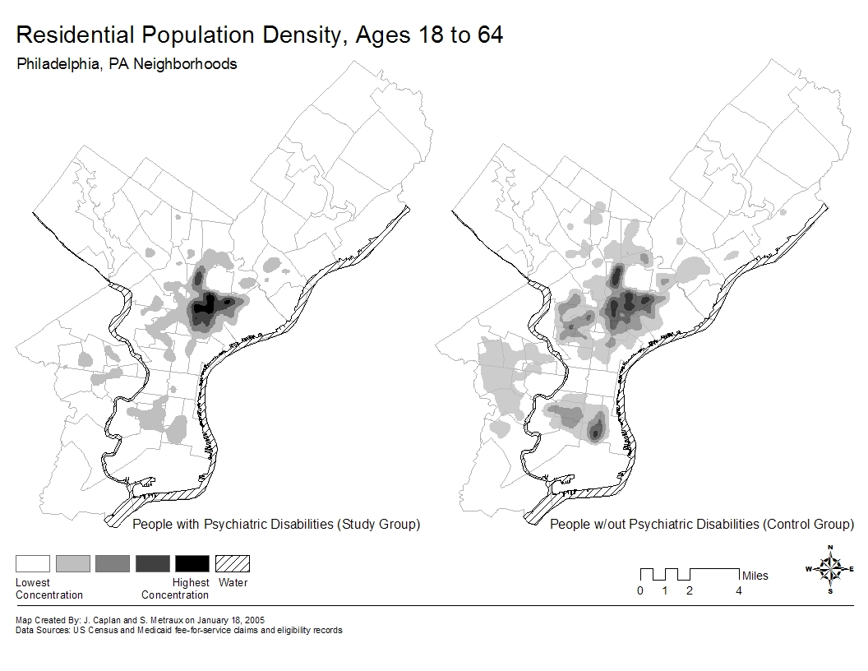
Modest Residential Segregation
From Metraux, Caplan, Klugman, Hadley (2007)

Slide 6
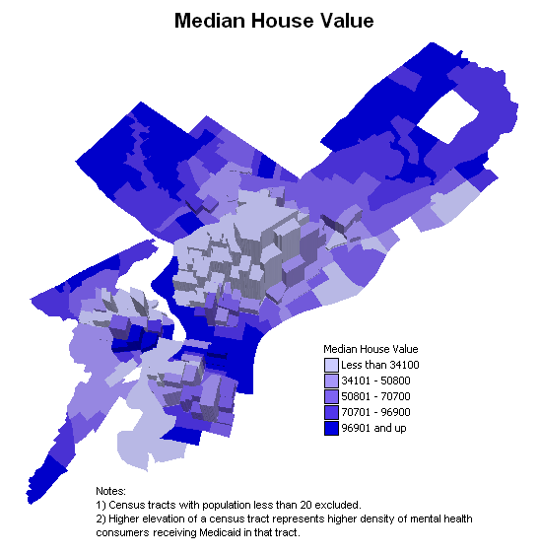
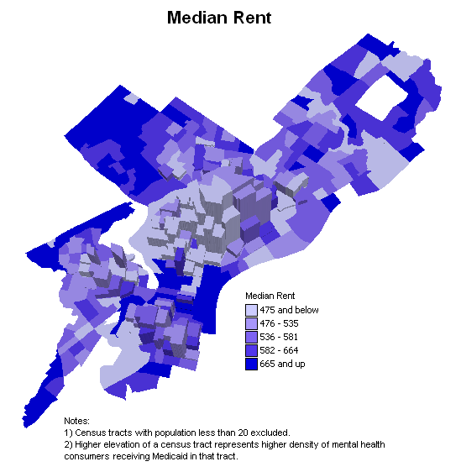
People Live Where Housing is Affordable

Slide 7
Are neighborhoods with a higher prevalence of SMI exposed to more social and physical disadvantages?
Byrne, T., Prvu Bettger, J.A., Brusilovskiy, E., Wong, Y.-L. I., Metraux, S., & Salzer, M.S. (2013). Comparing Neighborhood Characteristics of Adults with SMI and Members of the General Population in Philadelphia: Implications for Research and Practice. Psychiatric Services, 64(8), 782-788. doi: 10.1176/appi.ps.201200365.
Notes:
-Overarching objective in answering these questions is really to identify neighborhood characteristics that merit closer study/attention in future research as potential barriers/facilitators of community integration.
-Unfortunately, we don’t have any measures of community integration, so anything we might say about whether neighborhood characteristics either impede or help community integration would be purely speculation.
-In fact, some characteristics—as we’ll see—could go either way
--However, study important insofar it highlights differences in the neighborhood characteristics of SMI and general, and in light of emerging evidence, these differences should not be ignored.

Slide 8
Study Methods
SMI Data:
Addresses of 15,246 Medicaid recipients with schizophrenia or affective disorder in Philadelphia (same dataset as used in Metraux et al., 2007)
Includes individuals ages 18-64 who, over the period between 1997 and 2000 have had records of at least one inpatient or two outpatient Medicaid reimbursed services for which diagnoses of schizophrenia (295) or affective disorder (296) were recorded in the claims.
General Population Data
Generated 15,246 points (addresses) that are proportional to the distribution of the Philadelphia general population (1,517,550) among the 1816 block groups
Environmental Data
Block group level characteristics obtained from:
Census 2000
Databases maintained by the Cartographic Modeling Lab at the University of Pennsylvania
Collected 22 variables that described neighborhood social, physical and crime characteristics
Notes:
-Census
-CML databases include data from: Philadelphia Police, Department of Licenses & Inspections, BRT, PGW, Philadelphia Revenue Department

Slide 9
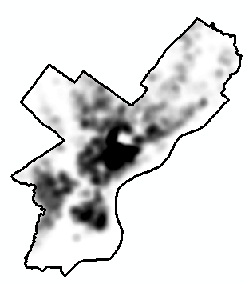
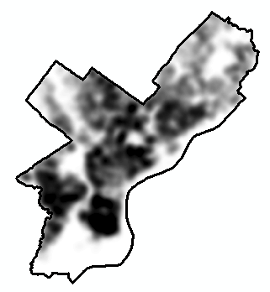
SMI Density General Pop. Density
A pixel with a density of 2.12, for instance, means that there are 2.12 individuals per acre in the (half mile) vicinity of that pixel

Slide 10
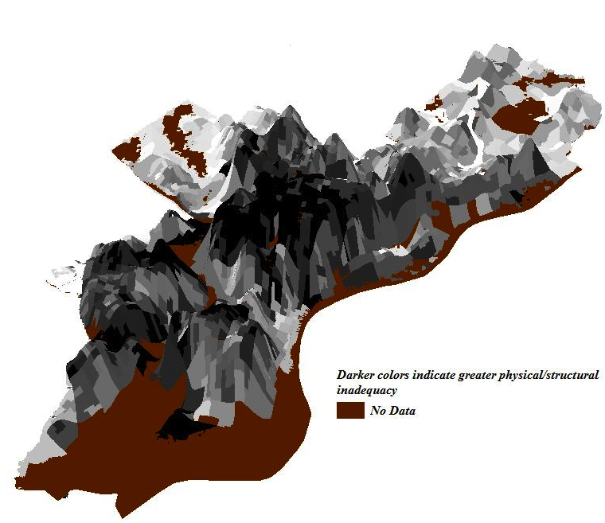
Physical/Structural Inadequacy

Slide 11
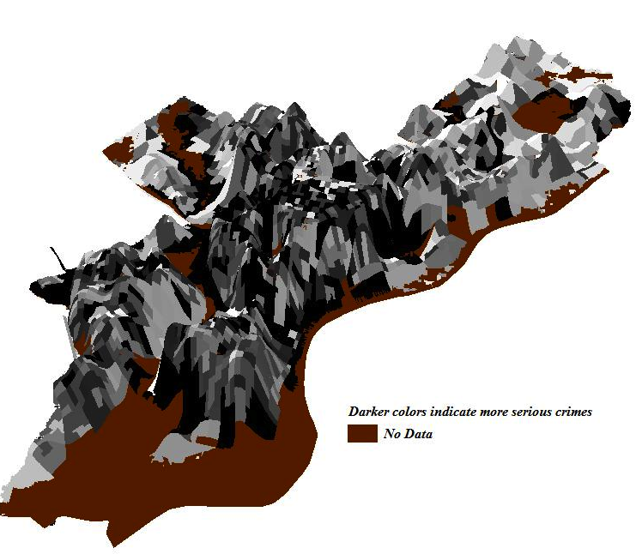
Serious Crime

Slide 12
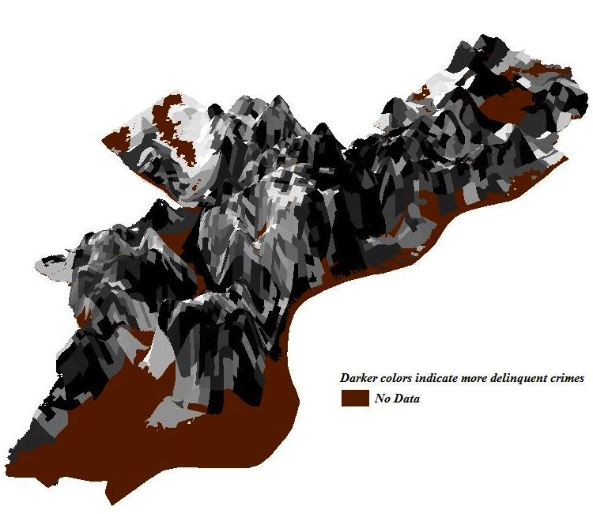
Delinquent Crime

Slide 13
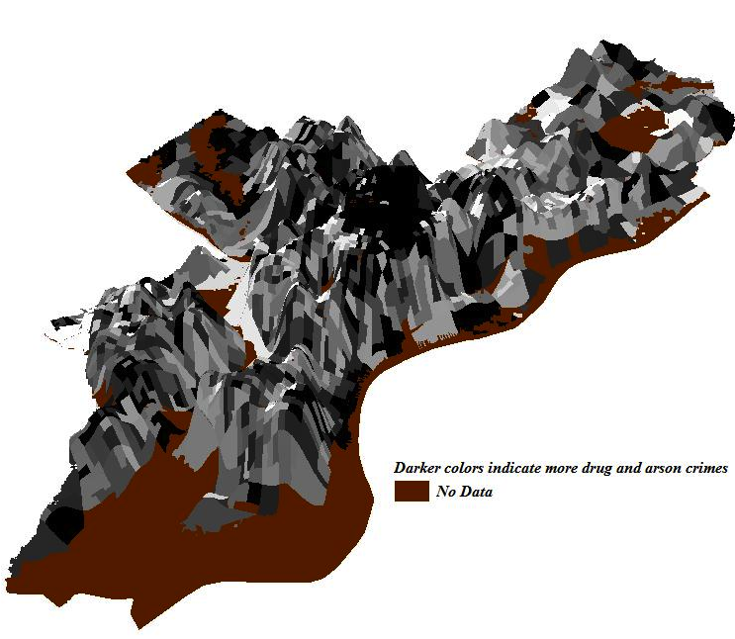
Drug Related Activity

Slide 14
Neighborhoods With Higher % of Individuals with a SMI are More Exposed to Social Problems than other neighborhoods
Variable | β | P-value
Serious Crime | 0.09 | <.0001
Delinquent Crime | 0.03 | 0.1791
Drug Related Activity | 0.25 | <.0001
Physical/Structural inadequacy | 0.39 | <.0001
Social Instability | 0.19 | <.0001
Social Isolation | 0.08 | <.0001
Block Group Population Ages 18-64 | -0.12 | <.0001
% Ages 18-64 | -0.19 | <.0001
% Non-white | <0.01 | 0.8412
% Male | <0.01 | 0.8670
N=1,785 F (10, 1773)=96.14, p<.0001, Adj. R-Square=.35

Slide 15
How much access to health care resources do people with serious mental illnesses have compared to the general population?
Metraux, S., Brusilovsky, E., Prvu-Bettger, J., Wong, Y.-L. I., & Salzer, M.(2012) Geographic access to and availability of community resources for persons diagnosed with severe mental illness in Philadelphia, USA. Health & Place, 18, 621-629.

Slide 16
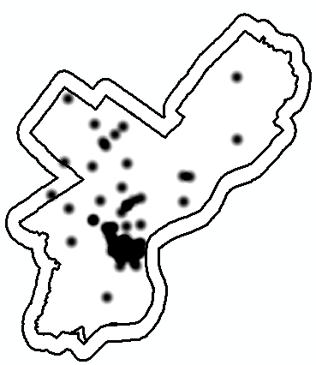
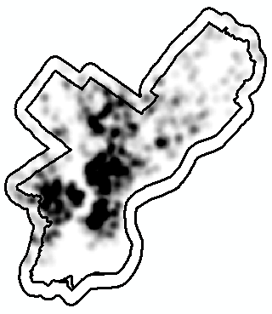
Museums, Art Galleries, Zoos, Botanical Gardens
Religious Organizations and Places of Worship

Slide 17
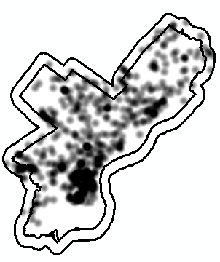
All Sports and Recreational Facilities
Eating and Drinking Establishments

Slide 18
Analyses
accessibility to amenities - the Euclidean distance between residence location (or comparison point) and the nearest location for each amenity type.
concentration of amenities - the number of locations for every resource type located with a half-mile buffer around each residence location (or comparison point).
accessibility and concentration were calculated using the Spatial Analyst Extension to ArcMap (ESRI 2006).
only one of those two measures could be assessed for some amenity categories.
T-test used to examine differences in the means for each measure of accessibility.

Slide 19
People with SMI Have Greater Access to Healthcare-Related Resources Than the General Population
 | Accessibility | Concentration
Health-Related Commercial Establishment
Pharmacies | + | +
Health & Mental Health Providers
Hospitals | + | --------
Community MH Centers & Providers | + | +

Slide 20
Does living in neighborhoods with higher SES, higher social capital, and lower crime rates lead to better psychosocial outcomes (i.e., better quality of life and lower symptoms & distress)?
Brusilovskiy E., and Salzer M.S. (2012). A Study of Environmental Influences on the Well-Being of Individuals with Psychiatric Disabilities in Philadelphia, PA. Social Science and Medicine, 74(10): 1591-1601.

Slide 21
Data
396 individuals with serious mental illnesses (schizophrenia or major depression) residing in Philadelphia completed the (baseline) interview (Disparities study)
Most interviews were completed in 2004
Participants were asked to provide their addresses
378 of the addresses could be geocoded

Slide 22
Results: More Questions than Answers
Symptoms: On both the CSI and HSCL we found that greater distress/symptoms was statistically significantly associated with lower neighborhood SES and Social Cohesion
Empowerment: Having higher empowerment was marginally associated with higher neighborhood SES and Social Cohesion
QOL: Having higher quality of life was marginally associated with higher neighborhood crime
Recovery: Having higher RAS scored was marginally associated with higher crime and higher neighborhood SES and Social Cohesion
Very low R² after controlling for individual level factors
Green space, Crime, and QOL/RAS

Slide 23
Global Positioning System (GPS)

Slide 24
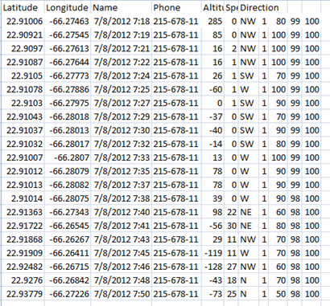
GPS Tracking
AccuTracking (accutracking.com)
Cell phone GPS tracking application
Location data collected at one-minute intervals and sent to a secure online database
Tracking starts and continues automatically when phone is on
Data exported into Excel: contain time, latitude, longitude variables
Data that are more than 30 days old are purged from the online database
Service costs about $10/month

Slide 25
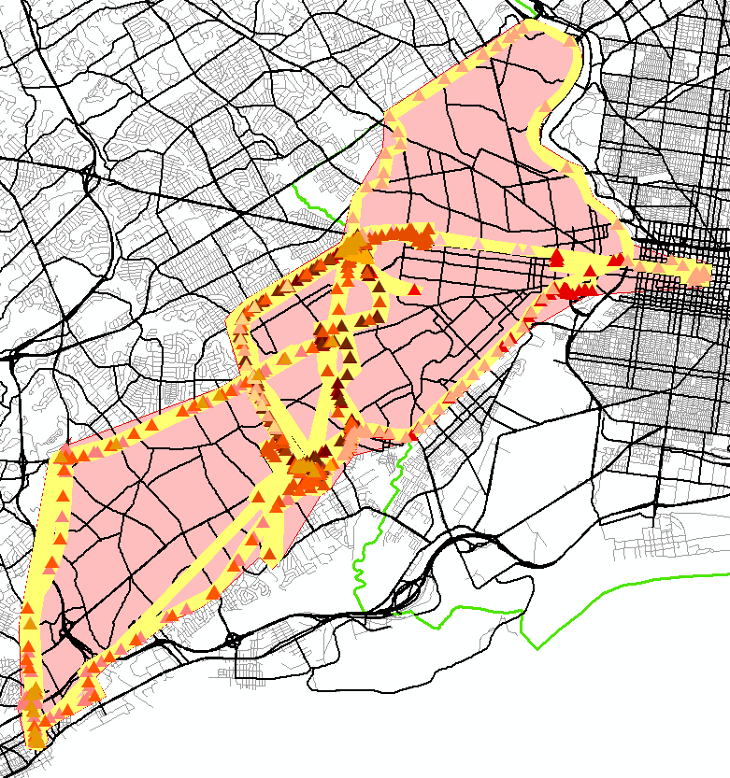
Mobility and Activity Spaces
The GPS points (triangles) were imported in ArcGIS to create daily activity spaces (seen in yellow)
Here, an activity space is used as a measure of mobility
The total activity space shapefile was created for each individual (seen in pink)
The layers were then brought into ArcScene to better visualize the participant’s movements throughout the study period
(seen on the next two slides)
All points from participant # 2, daily activity spaces (in yellow) and total activity space (in pink)

Slide 26
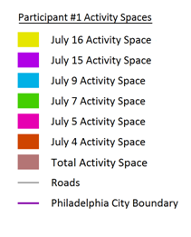
Participant 1 – Activity Space

Slide 27
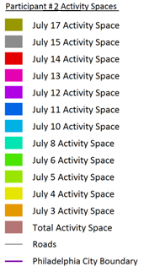
Participant 2 – Activity Space

Slide 28
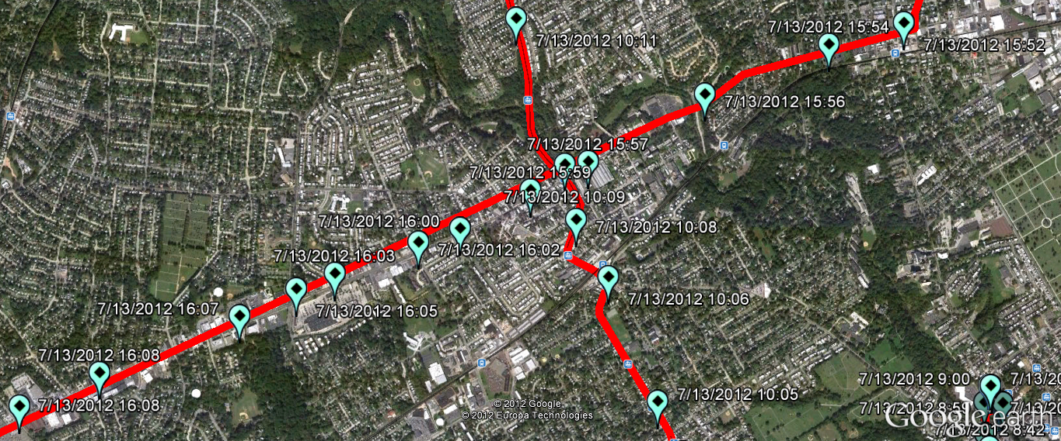
Destinations and Participation
Using a Program that Contains an algorithm that allows us to set parameters for “destinations.” For example, we might define a destination as location where there are at least 10 consecutive measurements (each 1-minute apart) within 500 feet of one another.
We then return to participants with a map and destination and ask what they were doing; with whom; and their level of satisfaction with the participation
Paths between the GPS points in Google Earth

Slide 29
Upcoming Research
Identifying enabling environments affecting adults with psychiatric disabilities. National Institute on Disability and Rehabilitation Research (H133G140040; 10/1/14 – 9/30/17)

Slide 30
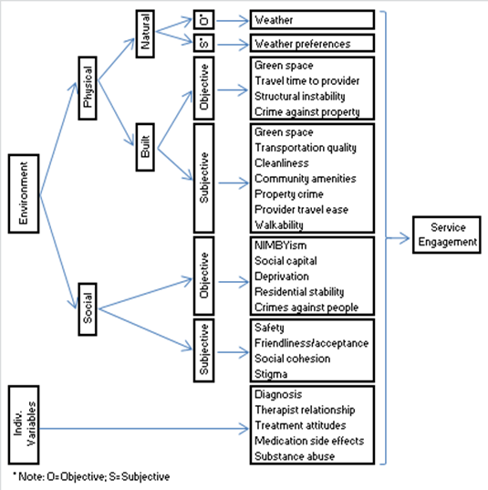
Studying Environmental Variables That May Affect Mobility and Participation
Mobility and Participation

